Slide 1
East Area Planning Committee
Presentation
    Oxford City Council – 11 Forest Road (No.1) Tree Preservation Order 2019
    Site Address: 11 Forest Road, Oxford

Slide 2
Tree Preservation Order Site Plan
T.1

Slide 3
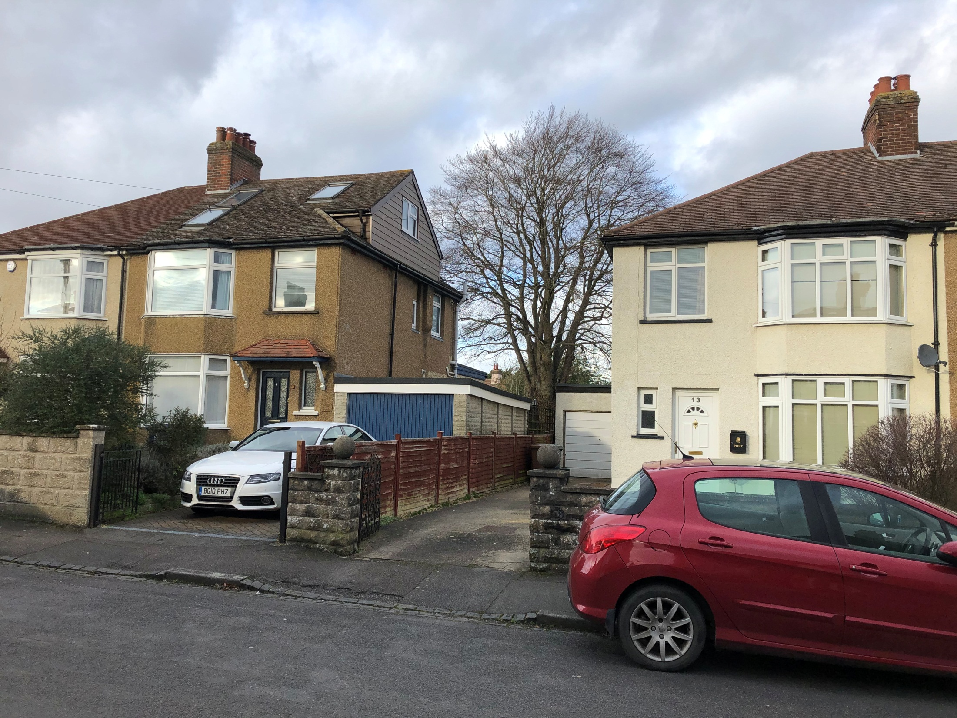
T1: Looking north from Forest Road

Slide 4
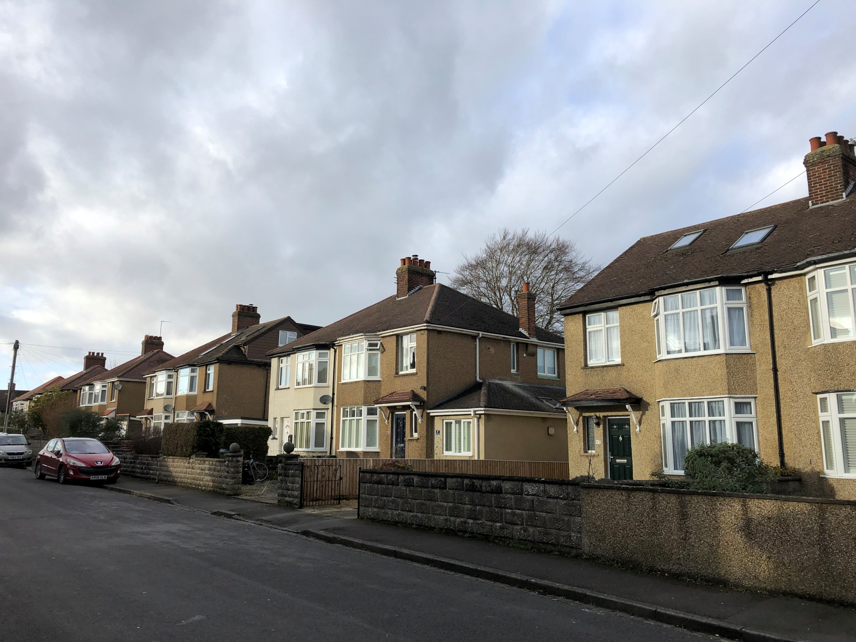
T1: Looking northwest from Forest Road

Slide 5
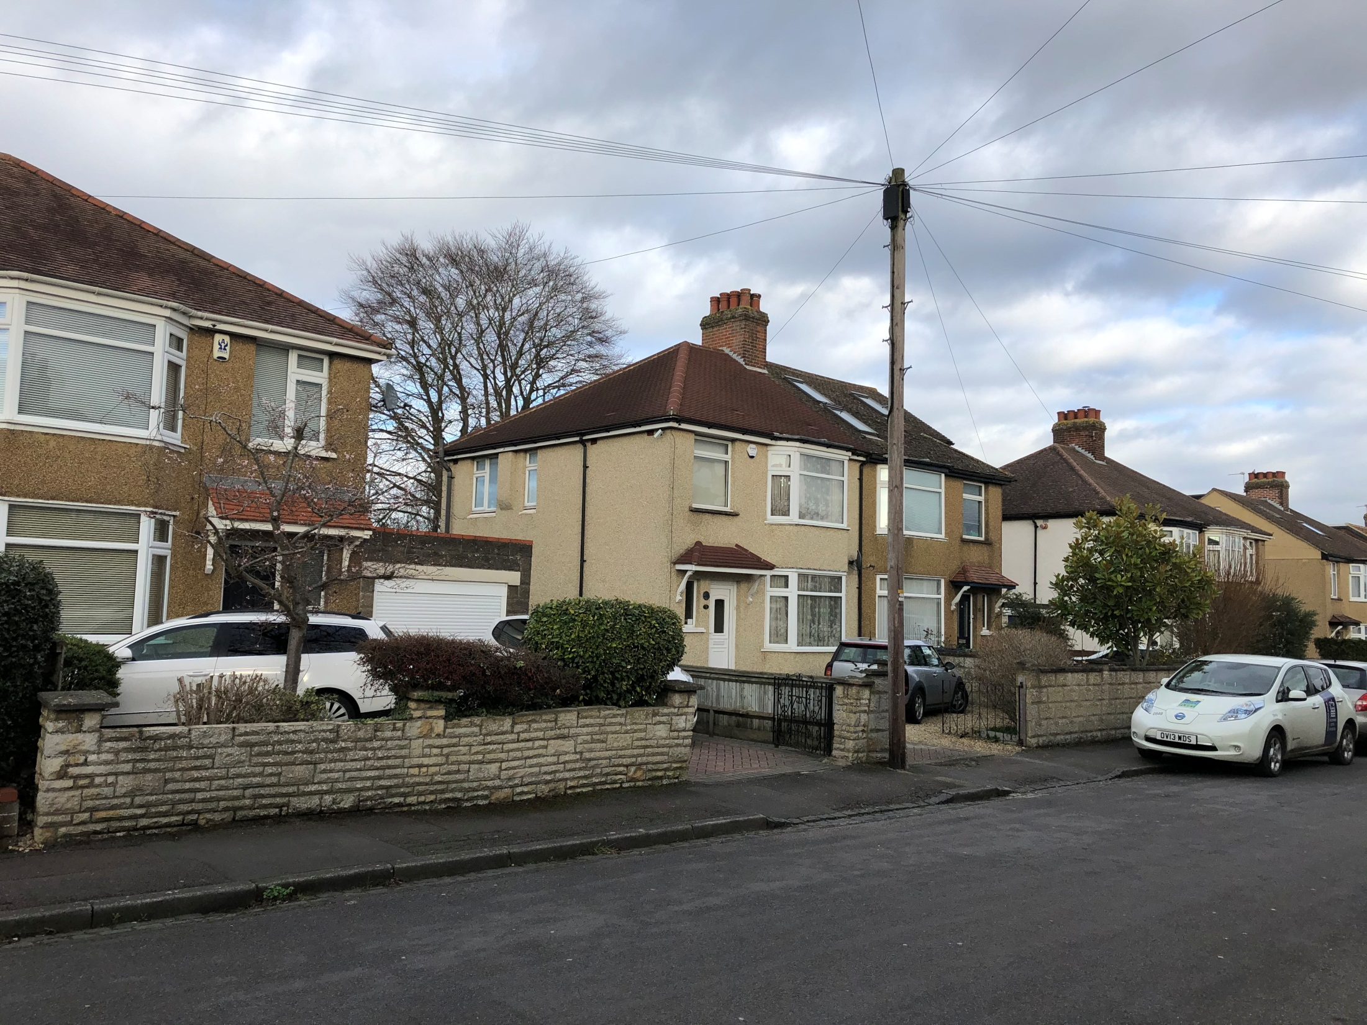
T1: Looking northeast from Forest Road

Slide 6
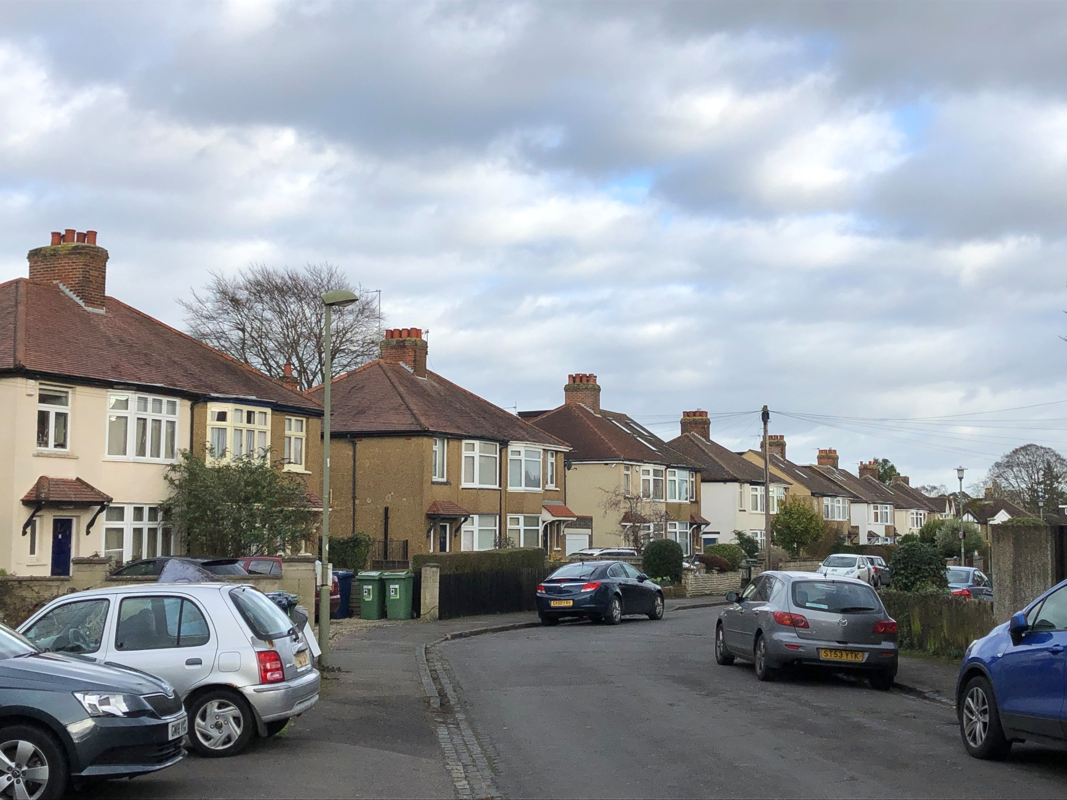
T.1
T1: Looking northeast from Forest Road (Green Road end)

Slide 7
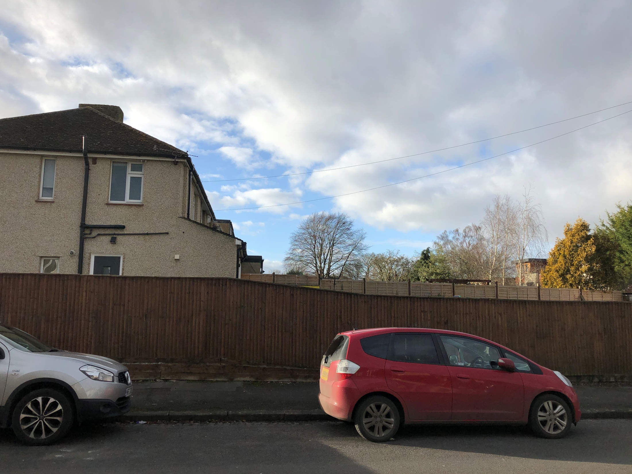
T.1
T1: Looking west from Ridgeway Road

Slide 8
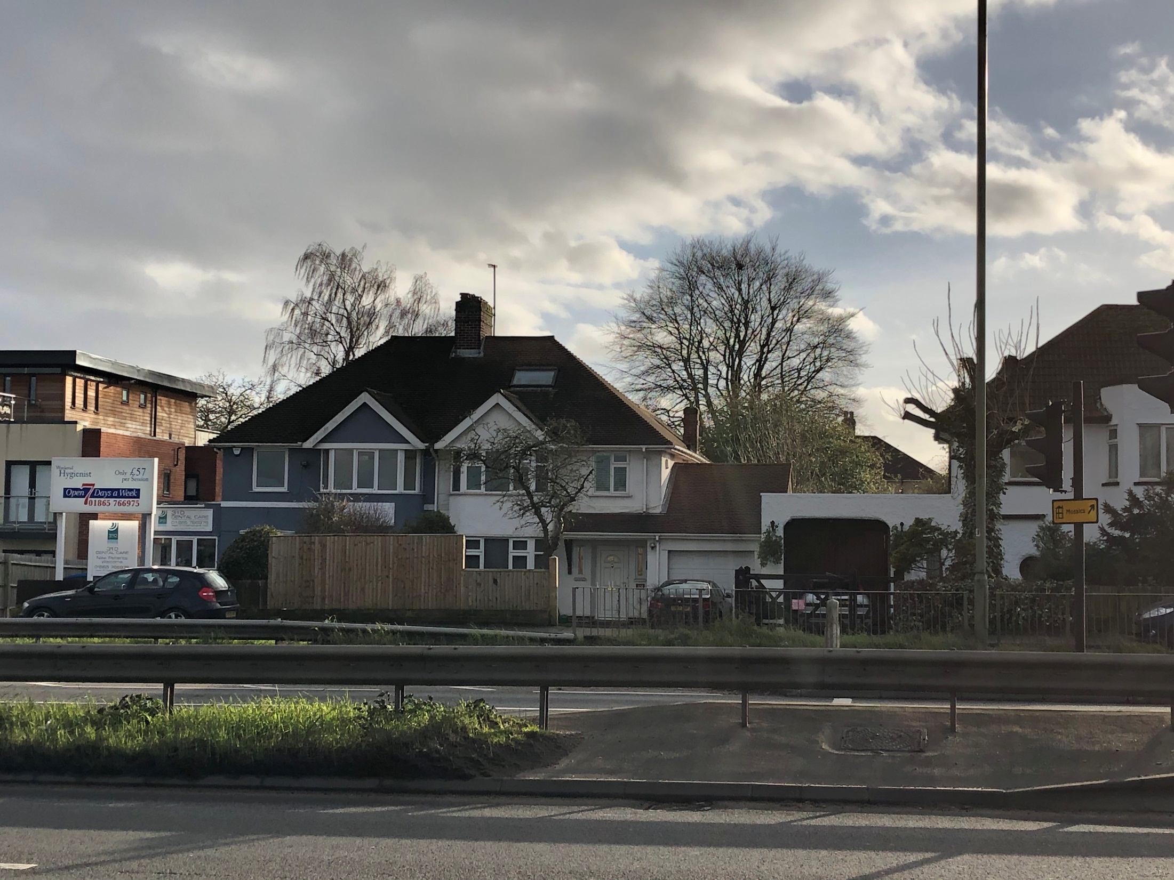
T.1
T1: Looking north from London Road (A40)

Slide 9
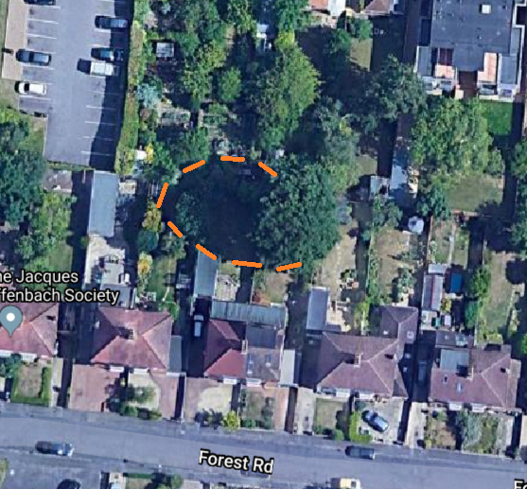
T.1
T1: Aerial view showing shade at around mid-day (estimated)

